Slide 1
Money Makers
Senior Capstone Project
Sprint 2
Gjergji Heqimi
Pete Iacona
Eric Le
Cole Pillars
Carl Welland
Notes:
Pete

Slide 2
Summary
Gjergji Heqimi
Password resets, database creation
Pete Iacona
MS Project file, UI Mockups
Eric Le
Registration validation, database schema
Cole Pillars
Setup web server, user login ability
Carl Welland
Account creation, mail server configuration
Notes:
All

Slide 3
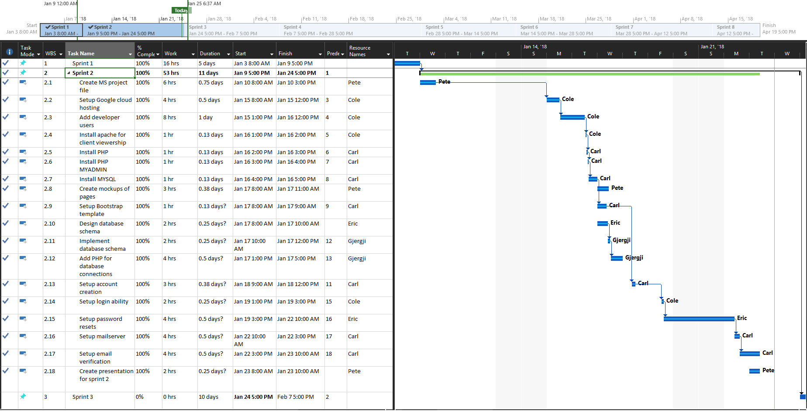
Gantt Chart
Notes:
Pete

Slide 4



Setup Web Server
Google cloud hosting
Add developer users
Install apache for client viewership
Install PHP
Install PHP MyAdmin
Install MYSQL
Notes:
Cole

Slide 5


Mail Server Configuration
Troubleshoot Mailgun, Mailjet, Mailx
Install Postfix
Sync Postfix with mail server sender address
Open specific ports for email
Test confirmation for email sending
Notes:
Carl

Slide 6
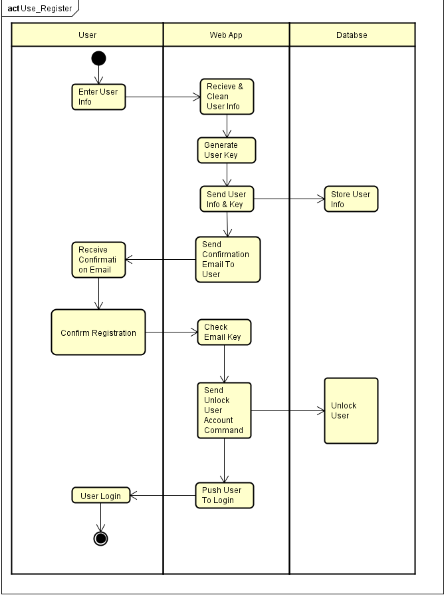
Account Registration
Get user input via POST and Validate
Check user does not exist
Send email confirmation with url for confirmation
Once user confirms email with url, unlock user
Push user to login page
Notes:
Carl

Slide 7
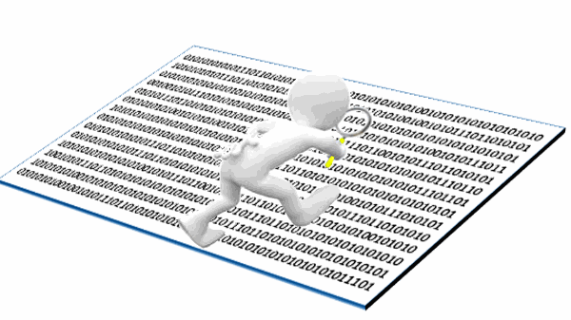

HTML
Input Data verification
Username
First & Last name
Password & Confirmation
Regular expressions
Password checking
Notes:
Eric

Slide 8
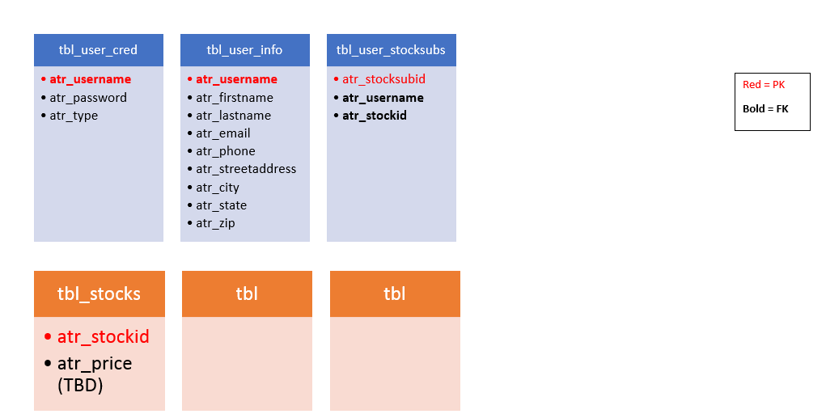
Schema
Key
Foreign key
Bold
Primary key
Red
To be expanded
Notes:
G

Slide 9
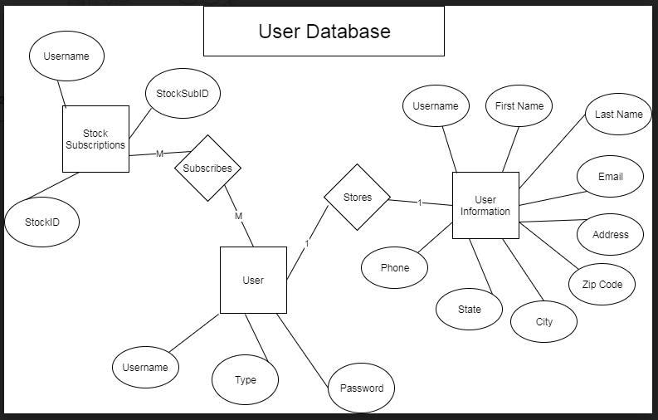
ERD
Notes:
G

Slide 10
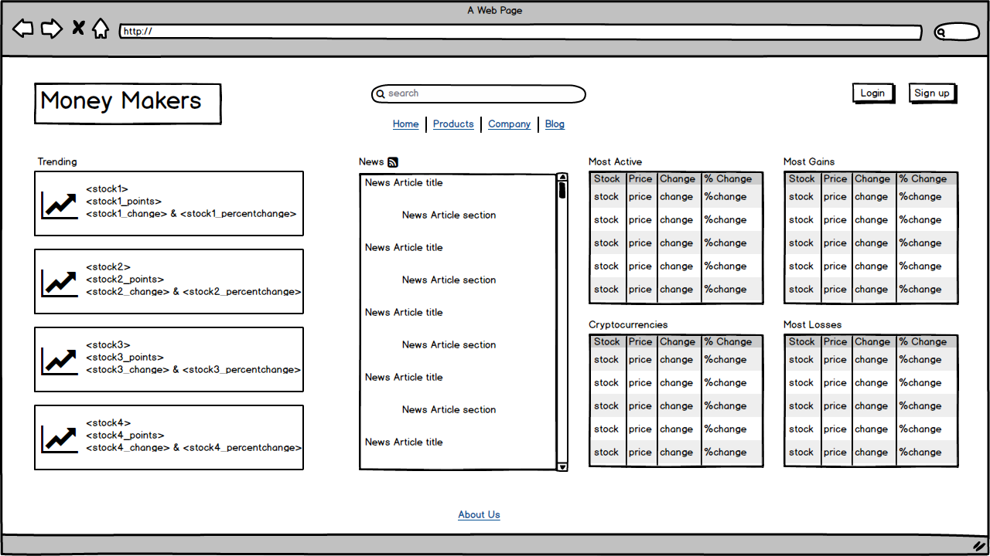
Mockups: Home Page
Notes:
Pete

Slide 11
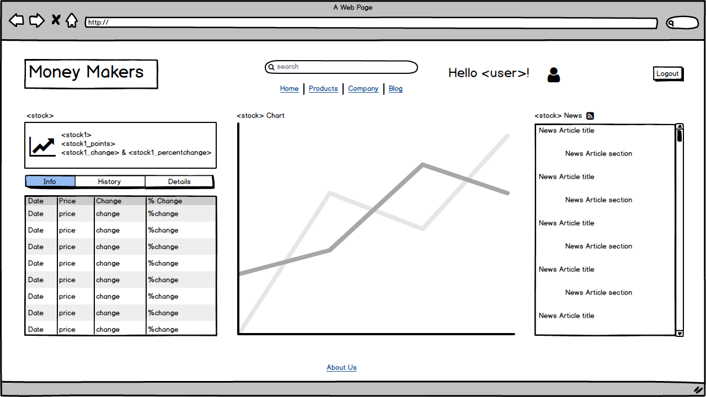
Mockups: Stock Page
Notes:
Pete

Slide 12
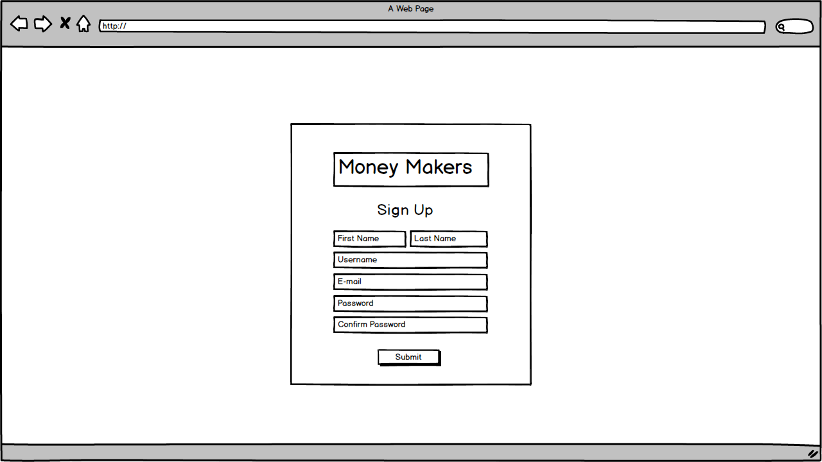
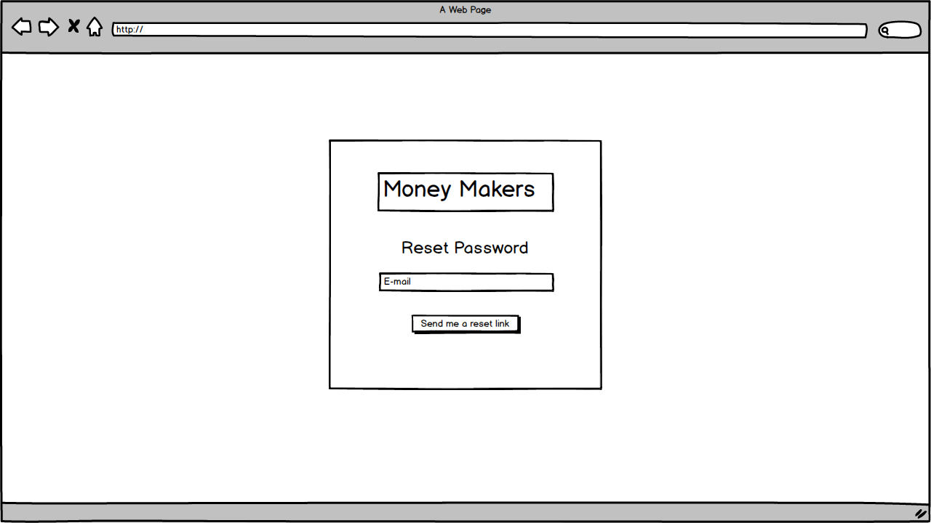
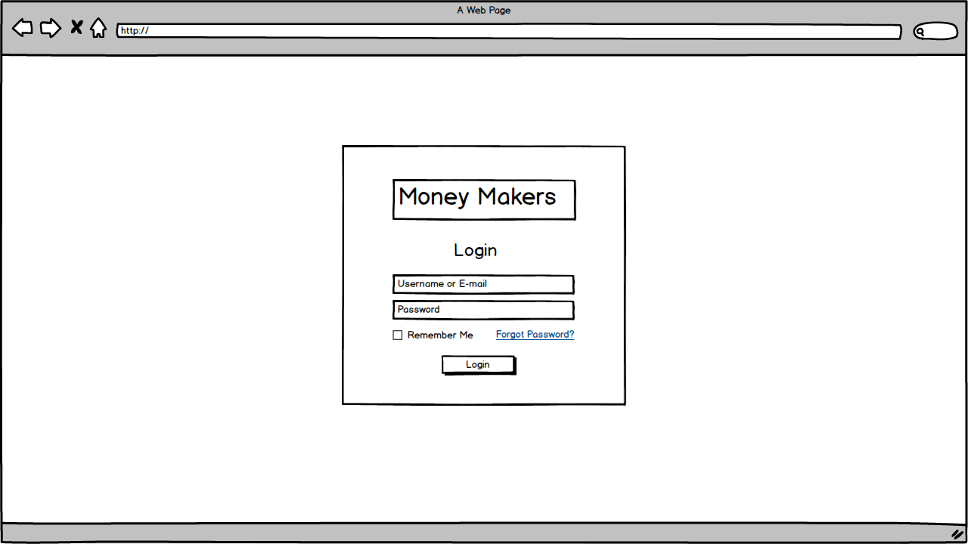
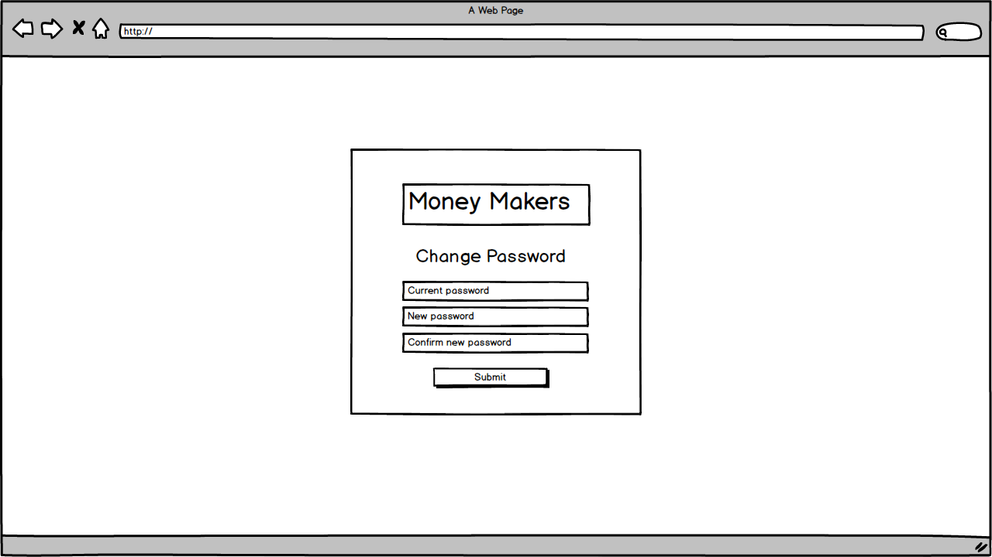
Mockups: Form pages
Notes:
G

Slide 13
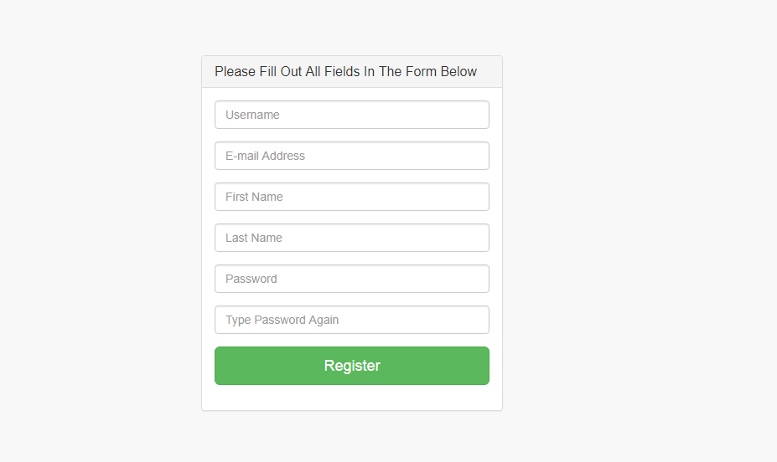
Registration page
Notes:
Eric

Slide 14

Demo

Slide 15

Plans for Sprint 3
Develop user stories
Implement security methods for logins
Create the UI for each page from the mockups
Choose a host to pull stock market data from
Populate screen elements with data
Notes:
Cole

Slide 16

Notes:
Cole

